Slide 1
Deep Learning for Computer Vision with Python
20190101 김규리

Slide 2
Image Fundamentals

Slide 3
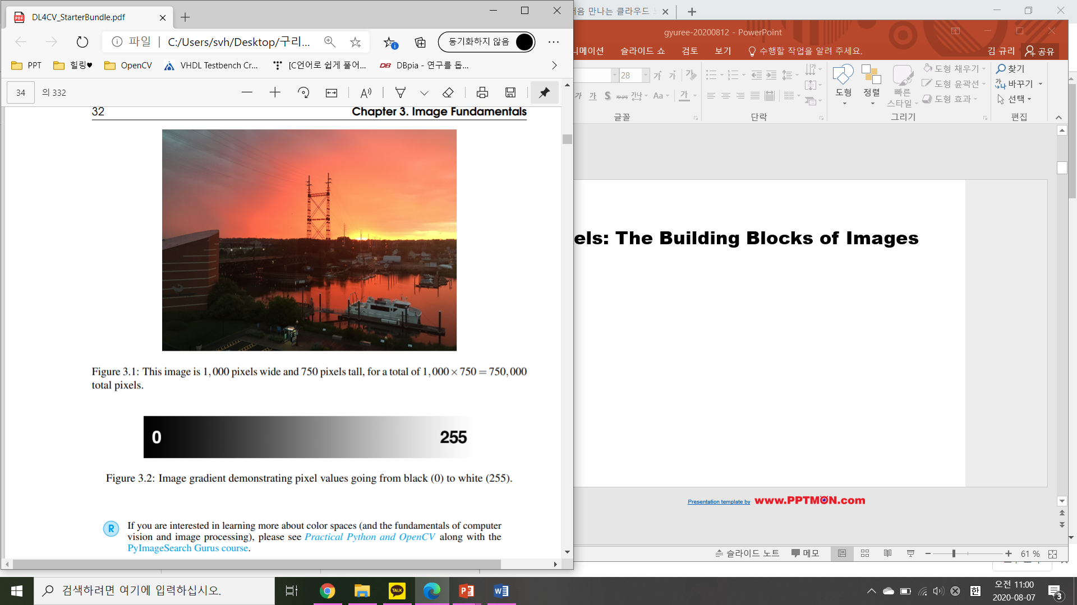
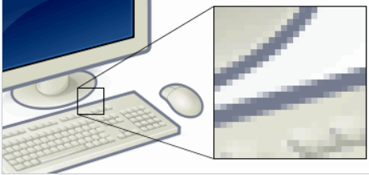
Pixels: The Building Blocks of Images
750
그림자료 출처: 위키백과
1000

Slide 4
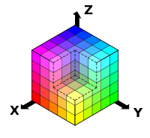
Pixels: The Building Blocks of Images
01.
Grayscale/single channel
02.
Color
RGB –cube 그림자료 출처: 위키백과

Slide 5
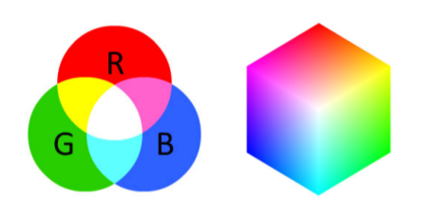
Pixels: The Building Blocks of Images

Slide 6
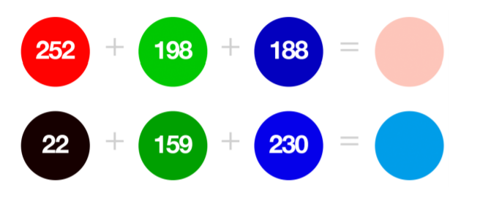
Pixels: The Building Blocks of Images

Slide 7
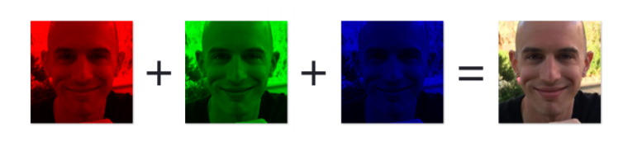
Forming an Image From Channels
W X H X D

Slide 8
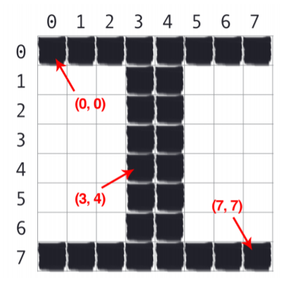
The Image Coordinate System

Slide 9
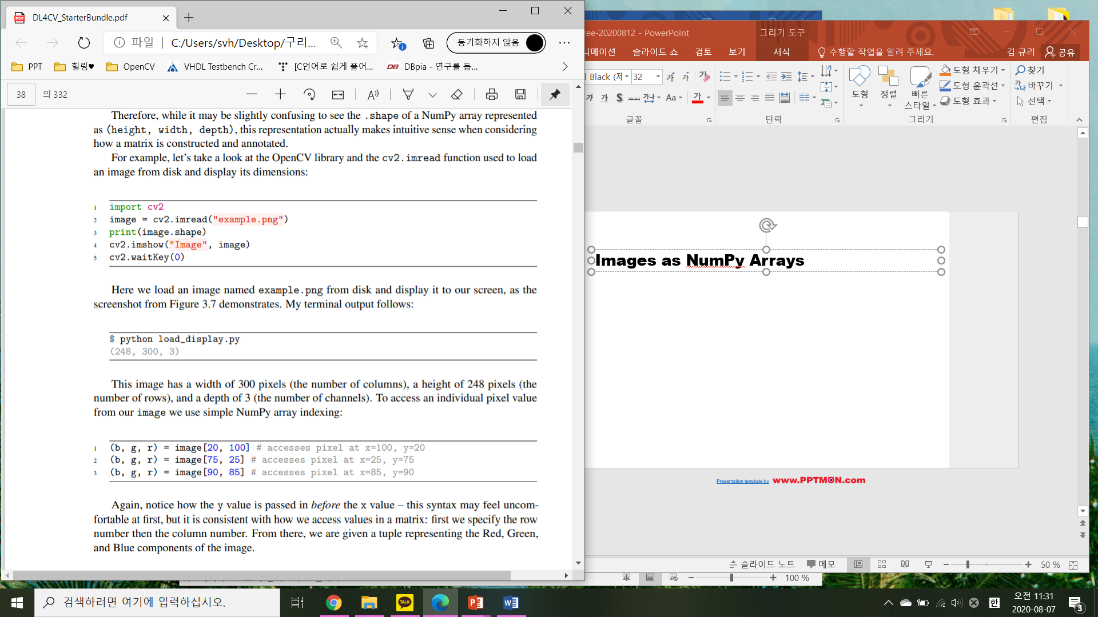
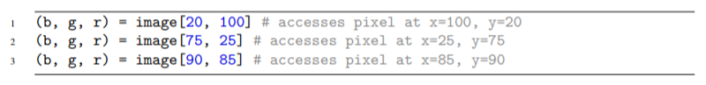
Images as NumPy Arrays

Slide 10
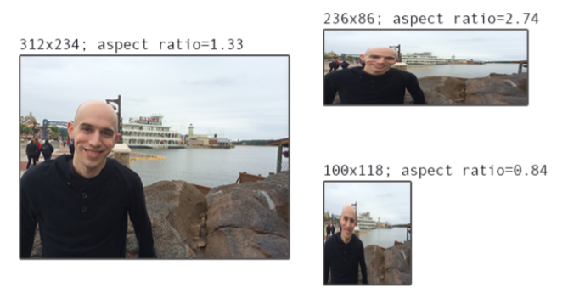
Scaling and Aspect Ratios
32×32, 64×64, 224×224, 227×227, 256×256 299×299

Slide 11
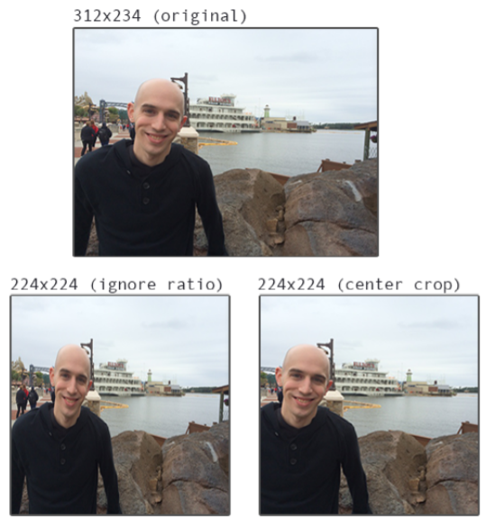
Scaling and Aspect Ratios
DATASET
312 X 234
224 X 224
800 X 600
770 X 300

Slide 12
Image Classification Basics

Slide 13
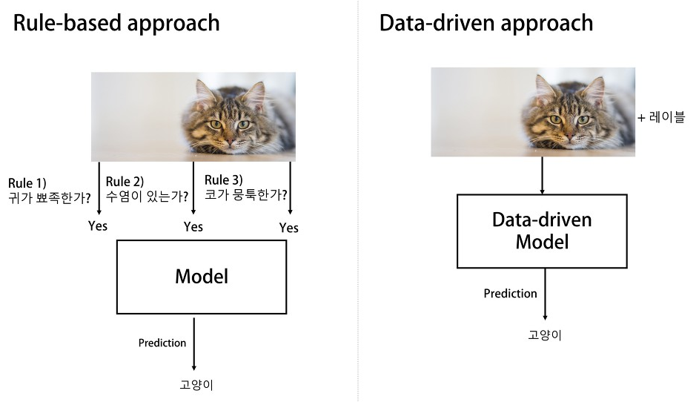
Rule-based approach vs. Data-driven approach
그림자료 출처: https://3months.tistory.com/512

Slide 14
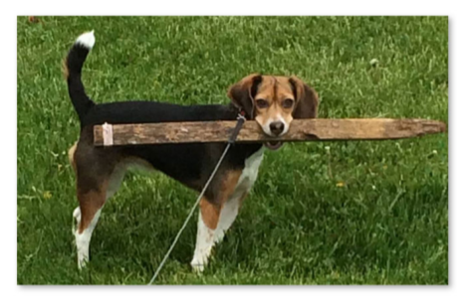
Image Classification

Slide 15
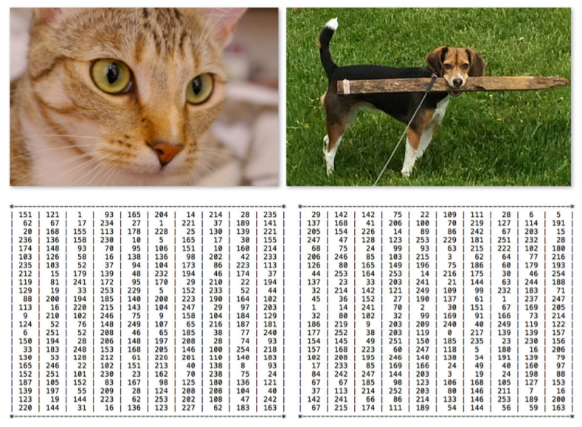
The Semantic Gap

Slide 16
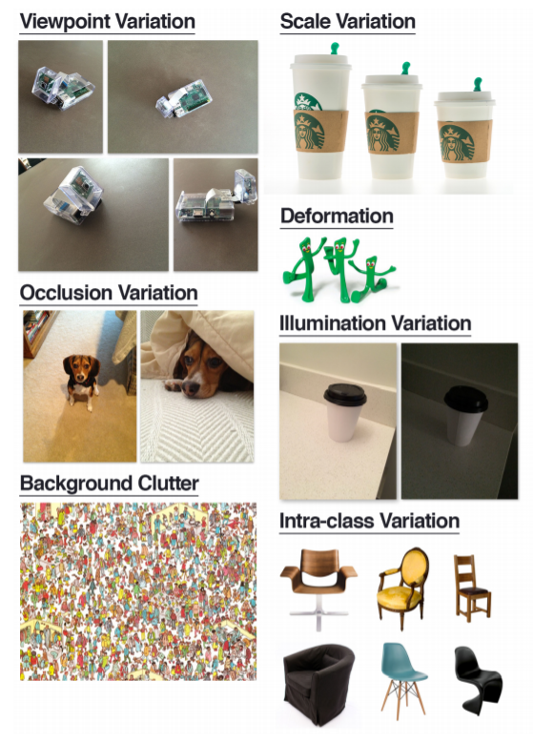
Challenges

Slide 17
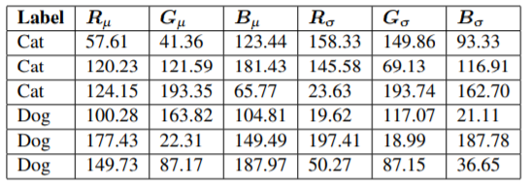
Supervised Learning
Logistic Regression, Support Vector Machines (SVMs), Random Forests, and Artificial Neural Networks

Slide 18
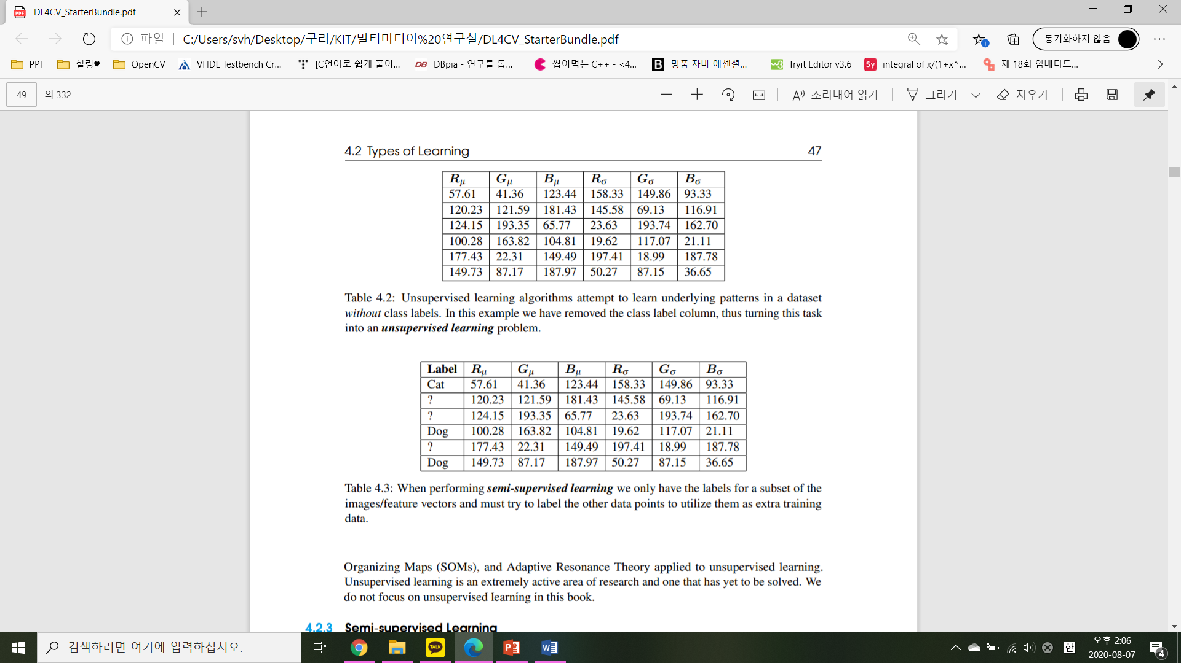
Unsupervised Learning
Principle Component Analysis (PCA) and k-means clustering

Slide 19
Semi-supervised Learning
label spreading, label propagation, ladder networks, and co-learning/co-training

Slide 20
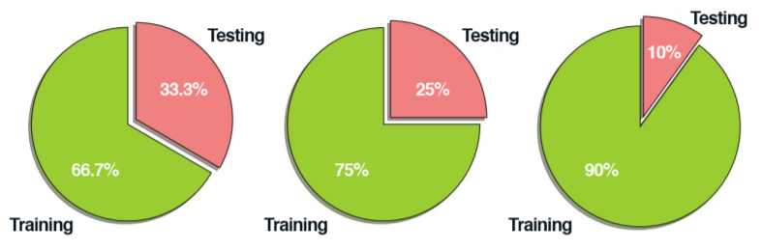
Constructing a deep learning model
01.
Gather Your Dataset
02.
Split Your Dataset

Slide 21
Constructing a deep learning model
03.
Train Your Network
04.
Evaluate

Slide 22
Datasets for Image Classification

Slide 23
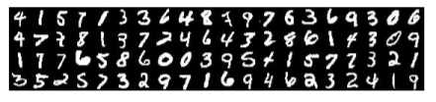
MNIST

Slide 24
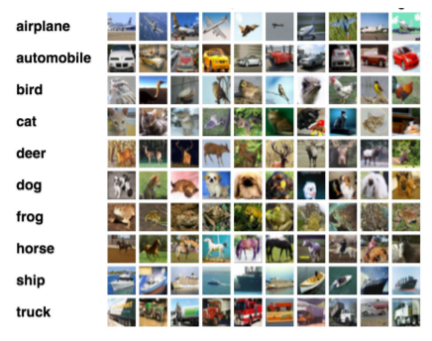
CIFAR-10

Slide 25
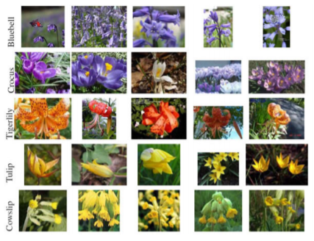
Flowers-17

Slide 26
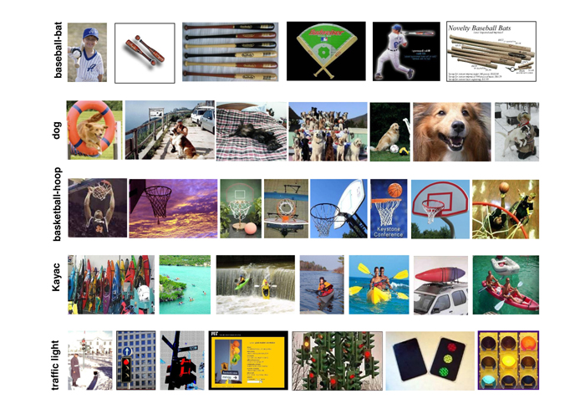
CALTECH-101

Slide 27
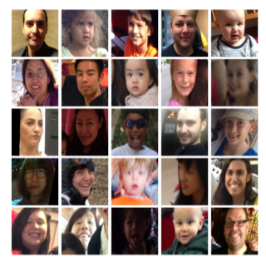
Adience

Slide 28
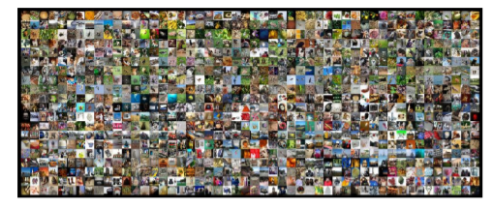
ImageNet

Slide 29
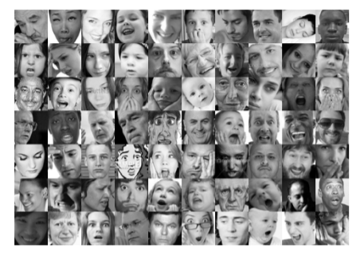
Kaggle: Facial Expression Recognition Challenge

Slide 30
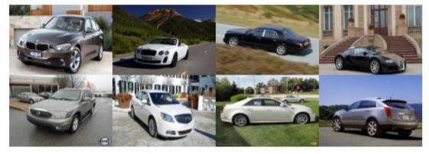
Stanford Cars

Slide 31
Q & A

Slide 32
Thanks !
감사합니다!
출처 표시되지 않은 모든 이미지 출처: 책 < Deep Learning for Computer Vision with Python>

